Slide 1
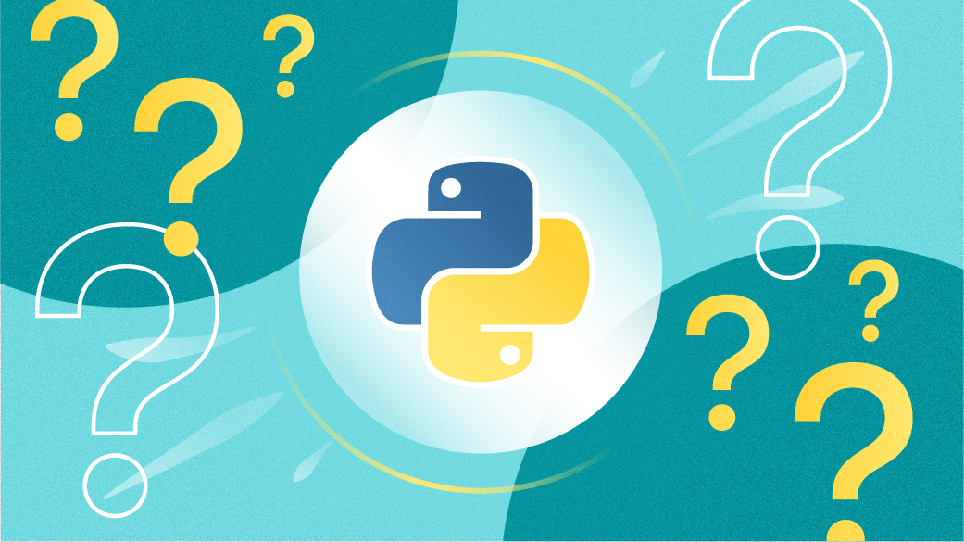

Python - Control Flow
By Chakin Kim

Slide 2
Preamble
Python program control flow is regulated by various types of conditional statements, loops, and function calls.
By default, the instructions in a computer program are executed in a sequential manner, from top to bottom, or from start to end.
However, such sequentially executing programs can perform only simplistic tasks.
We would like the program to have a decision-making ability, so that it performs different steps depending on different conditions.

Slide 3
Control Flow Statements
Decision Making Statements
Decision making statements are used in the Python programs to make them able to decide which of the alternative group of instructions to be executed, depending on value of a certain Boolean expression.
Loops or Iteration Statements
Most of the processes require a group of instructions to be repeatedly executed. In programming terminology, it is called a loop. Instead of the next step, if the flow is redirected towards any earlier step, it constitutes a loop.
3. Jump Statements
The jump statements are used to jump on a specific statement by breaking the current flow of the program. In Python, there are two jump statements break and continue.

Slide 4
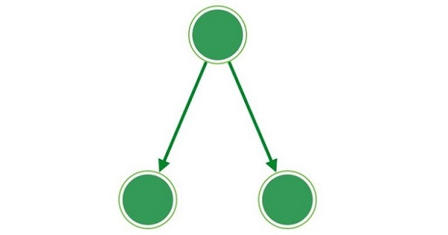
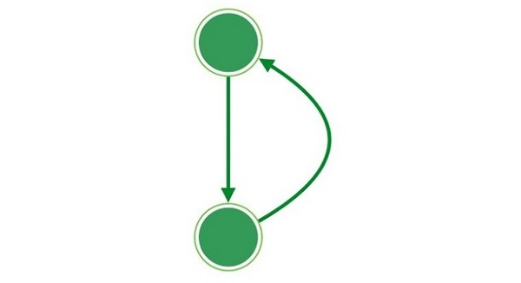
Graphically Speaking
Decision Making Statements
Loops or Iteration Statements
Condition
Condition
TRUE
FALSE
Outcome 1
Outcome 2
Outcome

Slide 5
Decision Making Statements
marks = 80
result = ""
if marks < 30:
result = "Failed"
elif marks > 75:
result = "Passed with distinction"
else:
result = "Passed“
print(result)
The if Statements
Python provides if..elif..else control statements as a part of decision marking.
Following is a simple example which makes use of if..elif..else.
You can try to run this program using different marks and verify the result.

Slide 6
Decision Making Statements
def checkVowel(n):
match n:
case 'a': return "Vowel alphabet"
case 'e': return "Vowel alphabet"
case 'i': return "Vowel alphabet"
case 'o': return "Vowel alphabet"
case 'u': return "Vowel alphabet"
case _: return "Simple alphabet"
print (checkVowel('a’))
print (checkVowel('m’))
print (checkVowel('o'))
The match Statement
Python supports Match-Case statement, which can also be used as a part of decision making.
Following is a simple example which makes use of match statement.

Slide 7
Loops or Iteration Statements
words = ["one", "two", "three"]
for x in words:
print(x)
The for Loop
The for loop iterates over the items of any sequence, such as a list, tuple or a string.
Following is an example which makes use of For Loop to iterate through an array in Python:
Notes:
An array is a collection of items stored at contiguous memory locations. The idea is to store multiple items of the same type together. This makes it easier to calculate the position of each element by simply adding an offset to a base value, i.e., the memory location of the first element of the array (generally denoted by the name of the array).

Slide 8
Loops or Iteration Statements
i = 1
while i < 6:
print(i)
i += 1
The while Loop
The while loop repeatedly executes a target statement as long as a given boolean expression is true.
Following is an example which makes use of While Loop to print first 5 numbers in Python:

Slide 9
Jump Statements
x = 0
while x < 10:
print("x:", x)
if x == 5:
print("Breaking...")
break
x += 1
print("End")
The jump statements are used to jump on a specific statement by breaking the current flow of the program.
In Python, there are two jump statements break and continue.
The break Statement
It terminates the current loop and resumes execution at the next statement.
The following example demonstrates the use of break statement

Slide 10
Jump Statements
for letter in "Python": # continue when letter is 'h’
if letter == "h": continue
print("Current Letter :", letter)
The continue Statement
It skips the execution of the program block and returns the control to the beginning of the current loop to start the next iteration.
The following example demonstrates the use of continue statement -

